Slide 1

Choosing the Right Statistical Test
A Framework for Making Informed Decisions
Presenter: Nasim Reza
June 22, 2025

Slide 2

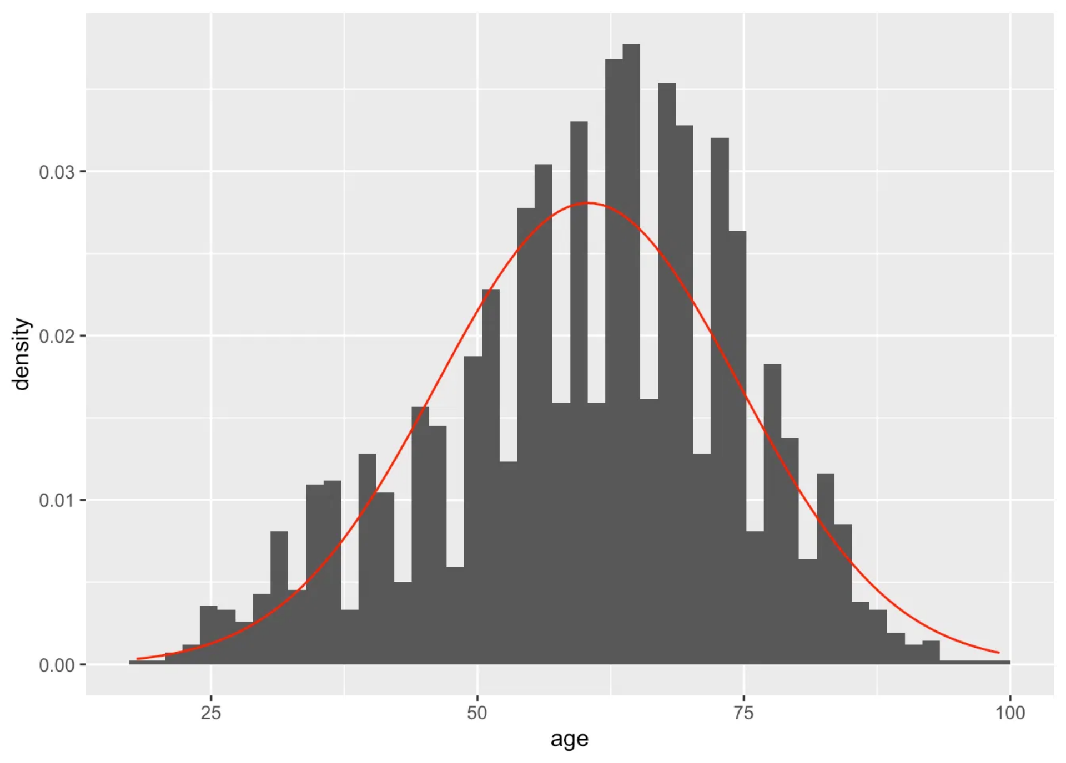
Key Questions Before Choosing a Test
What is your research question?
Is there a difference? Is there a relationship? Is there an effect over time?
What type of data do you have?
Nominal, Ordinal, Interval, Ratio
How many groups/variables are you comparing?
Two, three+, paired, independent
Are your data normally distributed?
Parametric vs. Non-parametric
Are your observations independent?
Independent vs. Dependent samples

Slide 3

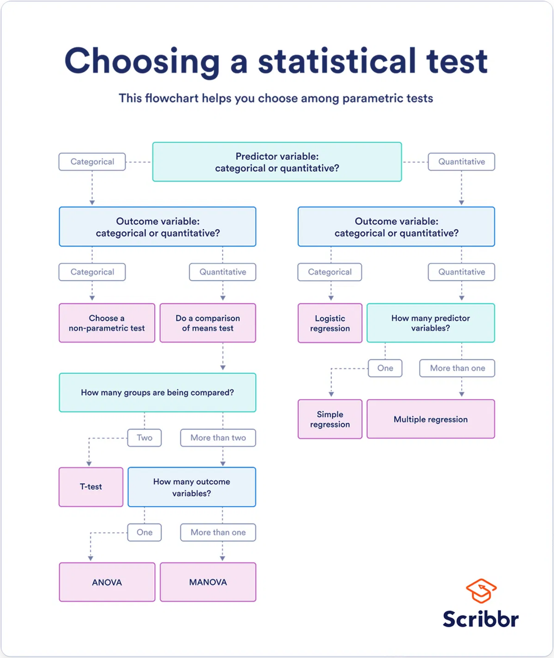
Statistical Test Selection Flowchart
This flowchart provides a high-level overview of the decision points for selecting the appropriate statistical test.

Slide 4

Comparing Two Independent Groups
Research Question: Is there a significant difference between two unrelated groups?
Parametric Option: Student's t-test
Non-parametric Alternative: Mann-Whitney U test
Assumptions:
Interval/Ratio data
When to Use:
Independence of observations
When assumptions for t-test are violated (especially normality/homogeneity).
Normality
Homogeneity of variances
Assumptions:
When to Use:
Ordinal/Interval/Ratio data
Comparing means of two independent groups.
Independence of observations
Purpose:
Comparing medians (or distributions) of two independent groups when data are not normal or are ordinal.

Slide 5
Comparing Two Dependent (Paired) Groups
Research Question: Is there a significant difference between two related measurements?
Parametric Option: Paired t-test
Non-parametric Alternative: Wilcoxon signed-rank test
Assumptions:
Interval/Ratio data
When to Use:
Independence of pairs
When assumptions for paired t-test are violated (especially normality of differences).
Normality of the differences between pairs
When to Use:
Assumptions:
Comparing means of two paired samples.
Ordinal/Interval/Ratio data
Independence of pairs
Examples: Pre/post measurements, matched pairs, repeated measures on same subjects
Purpose:
Comparing medians (or distributions) of two paired samples when data are not normal or are ordinal.

Slide 6
Comparing Three or More Independent Groups
Research Question: Is there a significant difference among three or more unrelated groups?
Parametric Option: One-way ANOVA
Non-parametric Alternative: Kruskal-Wallis H test
Assumptions:
Interval/Ratio data
When to Use:
Independence of observations
When assumptions for ANOVA are violated (especially normality/homogeneity).
Normality within groups
Homogeneity of variances
Assumptions:
When to Use:
Ordinal/Interval/Ratio data
Comparing means of three or more independent groups.
Independence of observations
Note: If ANOVA shows significance, post-hoc tests (e.g., Tukey's HSD) are needed to determine which specific groups differ.
Purpose:
Comparing medians (or distributions) of three or more independent groups when data are not normal or are ordinal.

Slide 7

Comparing Three or More Dependent Groups
Research Question: Is there a significant difference across three or more related measurements?
Parametric Option: Repeated Measures ANOVA
Non-parametric Alternative: Friedman test
Assumptions:
When to Use:
Interval/Ratio data
When assumptions for Repeated Measures ANOVA are violated.
Independence of subjects
Assumptions:
Normality of differences
Sphericity
Ordinal/Interval/Ratio data
Independence of subjects
When to Use:
Comparing means across three or more related samples.
Purpose:
Comparing medians across three or more related samples when data are not normal.

Slide 8

Analyzing Categorical Data
Research Question: Are observed frequencies/proportions different from expected, or is there an association between categorical variables?
For Independent Categorical Data
For Dependent Categorical Data
Chi-square test
McNemar's test
Assumptions:
Assumptions:
Independent observations
Paired nominal data
Expected cell counts > 5 (or a reasonable proportion)
When to Use:
When to Use:
Comparing proportions in paired samples (e.g., before/after intervention on a binary outcome).
Testing association between two categorical variables, or goodness-of-fit for one categorical variable.
Fisher's exact test
Assumptions:
Independent observations
When to Use:
Preferred over Chi-square when expected cell counts are very low (especially in 2x2 tables).

Slide 9

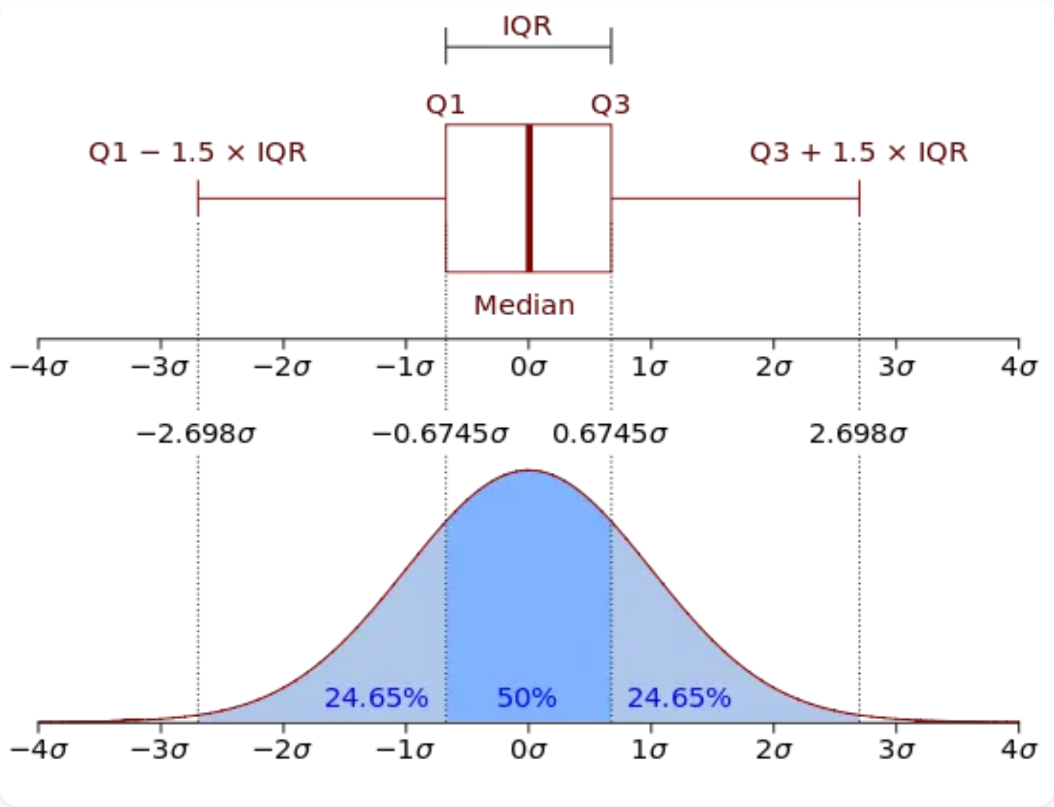


Before You Run the Test: Data Exploration is Key!
Proper exploration helps ensure your test selection is appropriate
Visualizing Data
Use histograms, box plots, and scatter plots to understand your data's distribution and relationships.
Checking for Outliers
Identify and decide how to handle extreme values that may influence your results.
Assessing Normality
Use Q-Q plots and Shapiro-Wilk test to check if your data follows a normal distribution.
Assessing Homogeneity of Variances
Use Levene's test to check if different groups have similar variances.
Visual inspection is often more informative than relying solely on statistical tests for assumptions!

Slide 10

A Checklist for Test Selection
Question
Your Response
Research Question:
What are you trying to find out?
Number of Variables/Groups:
How many are involved?
Variable Type(s):
Nominal, Ordinal, Interval, Ratio?
Independence of Observations:
Paired or Independent?
Distribution:
Normal or non-normal?
Assumptions Met?
Yes/No
Chosen Test:
Based on above criteria
Alternative Test (if needed):
If assumptions not met
This checklist can be used as a printable handout for future reference.

Slide 11

Thank You!
For taking the time to learn about selecting the right statistical test for your research needs.
Any Questions?

